Slide 1

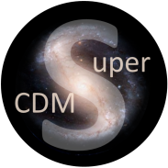
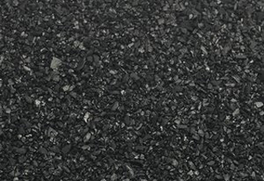
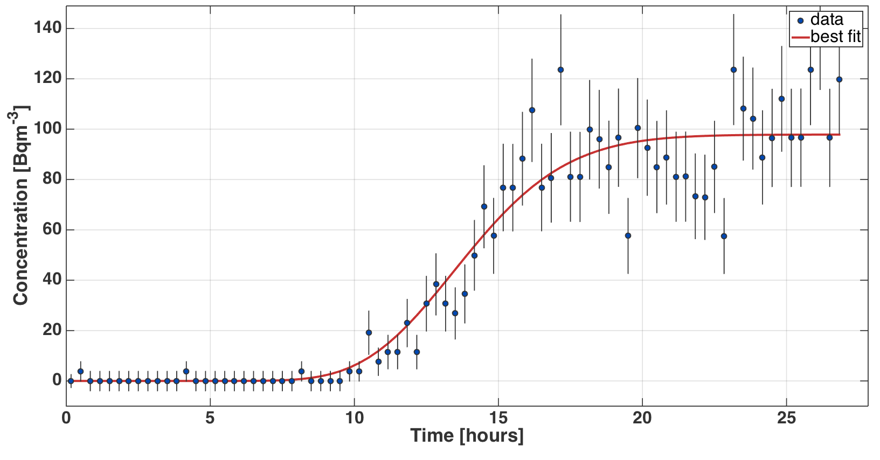
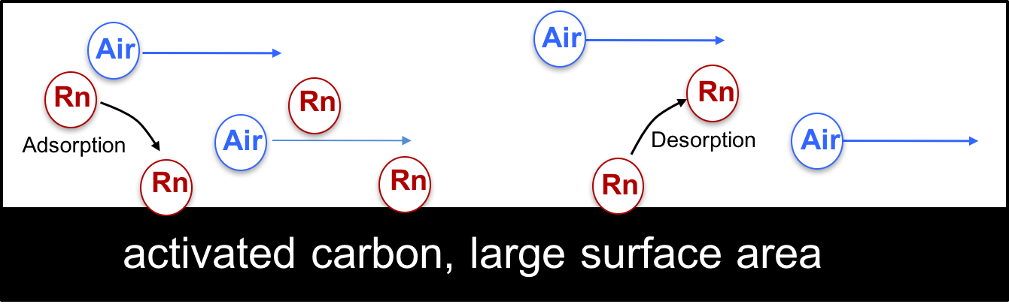
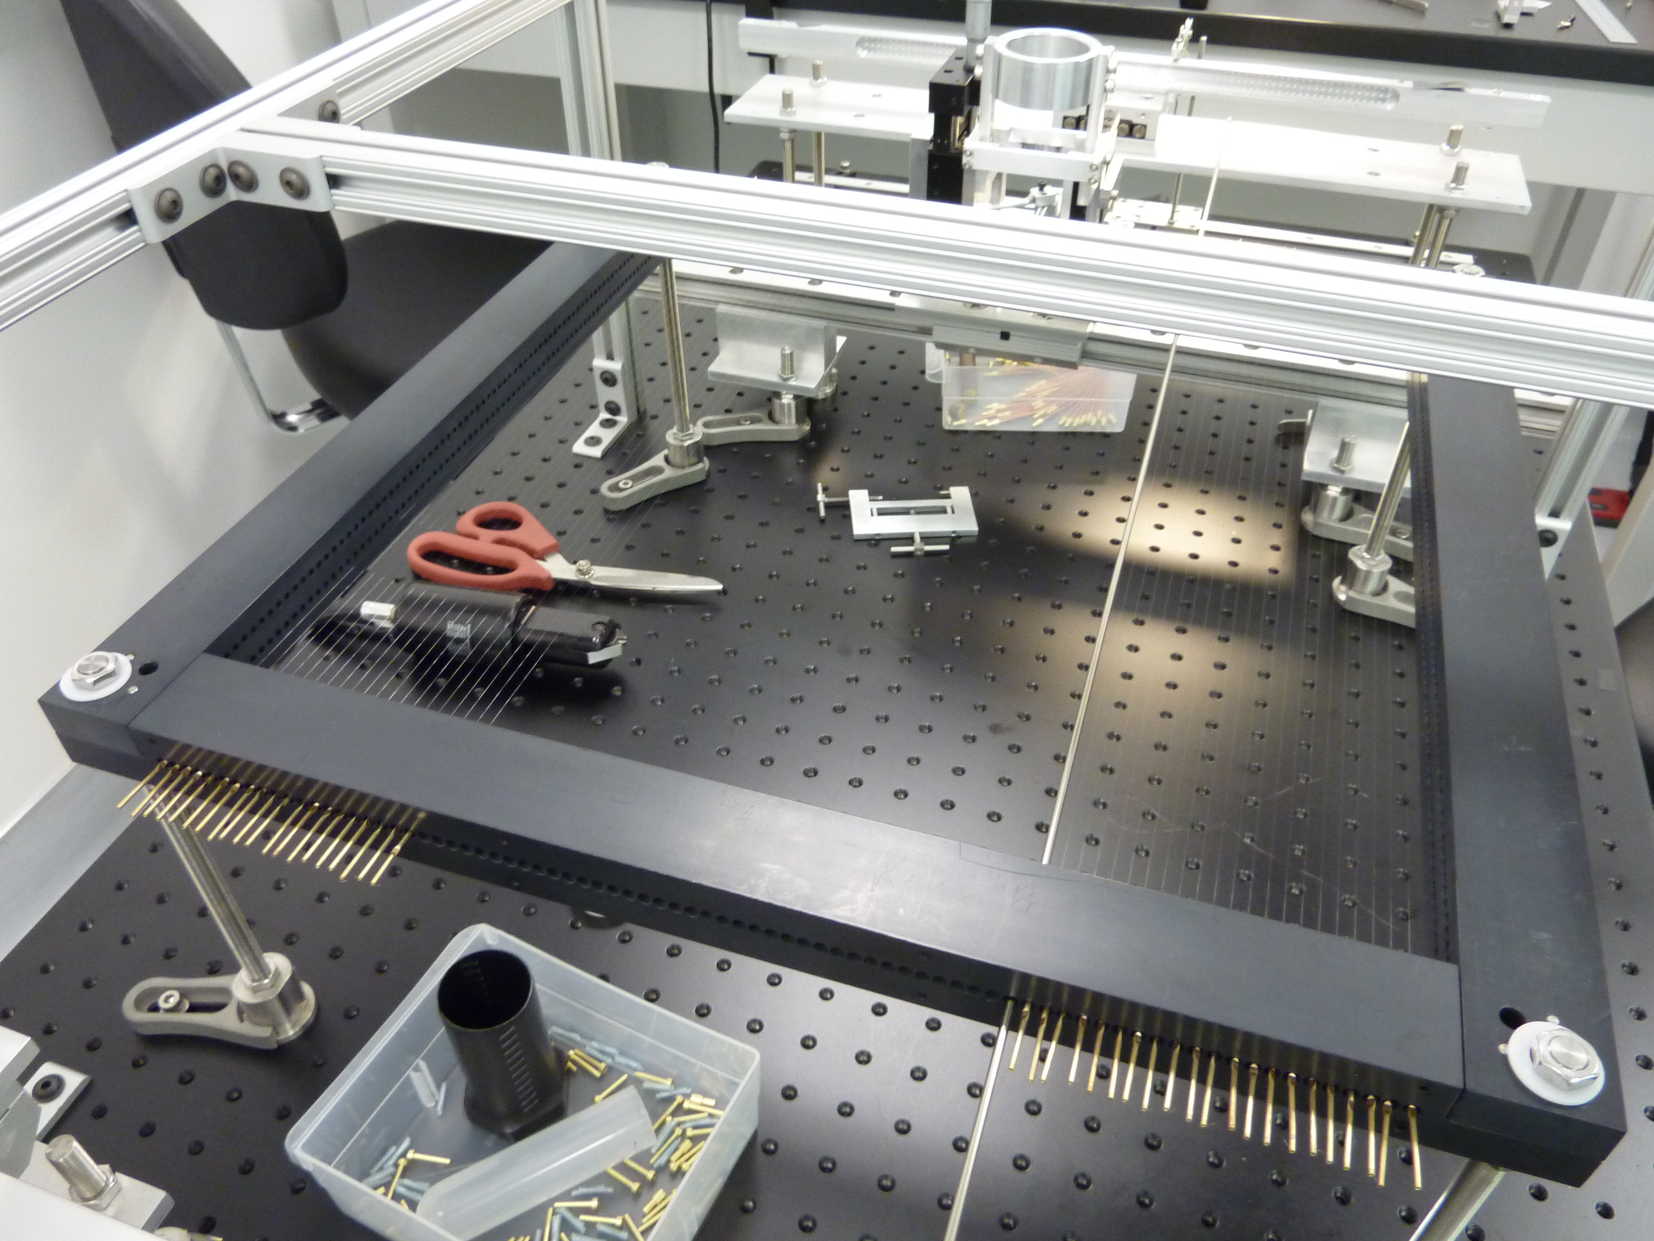
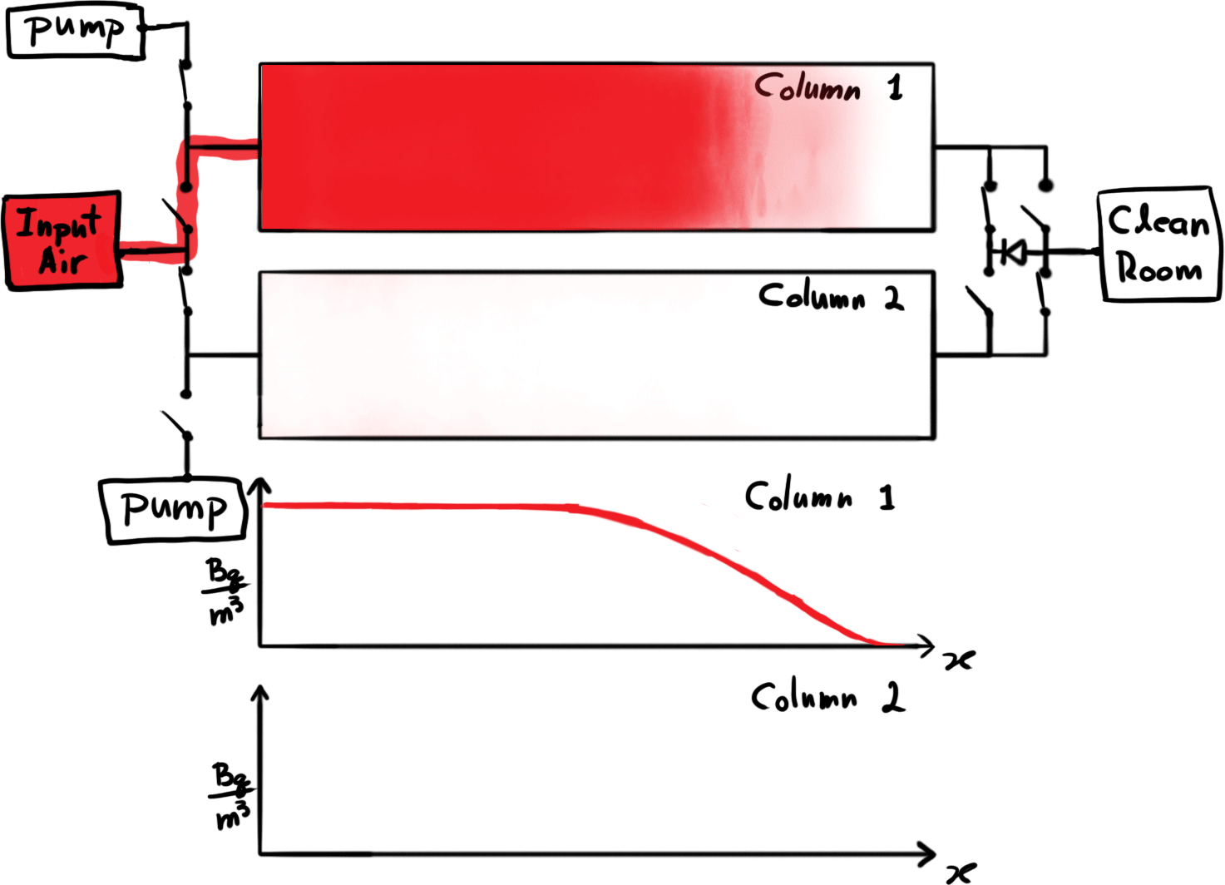
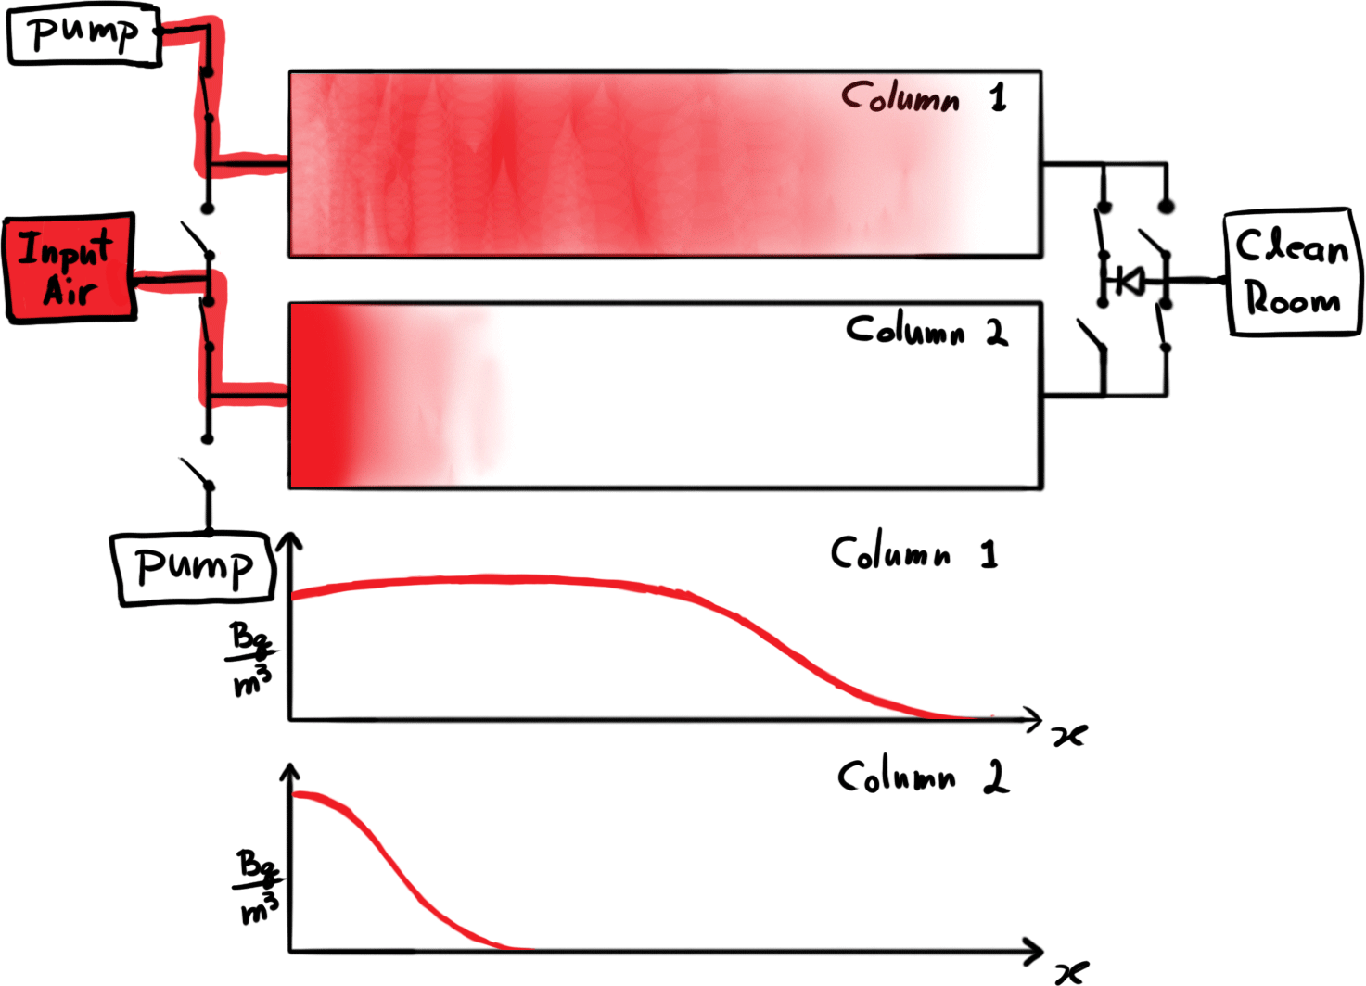
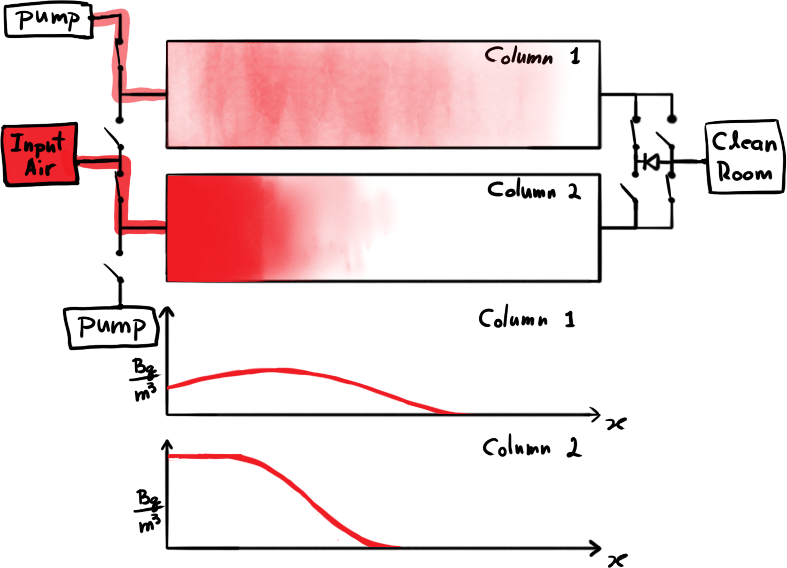
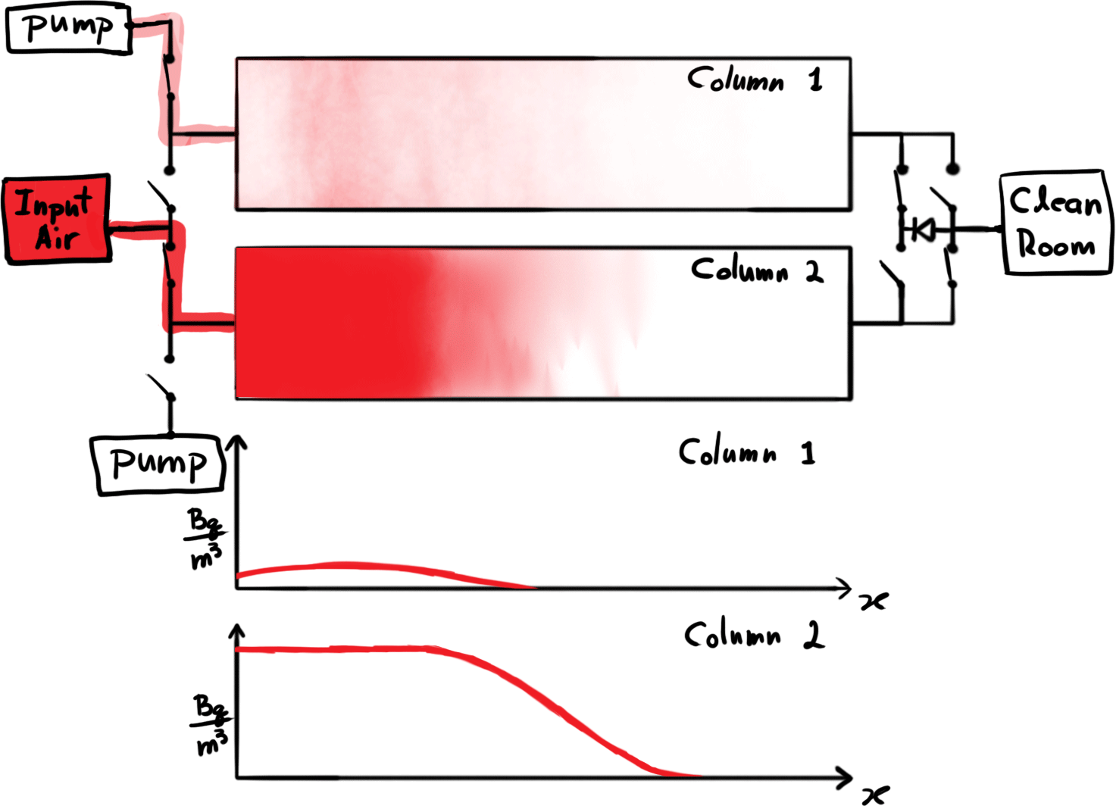
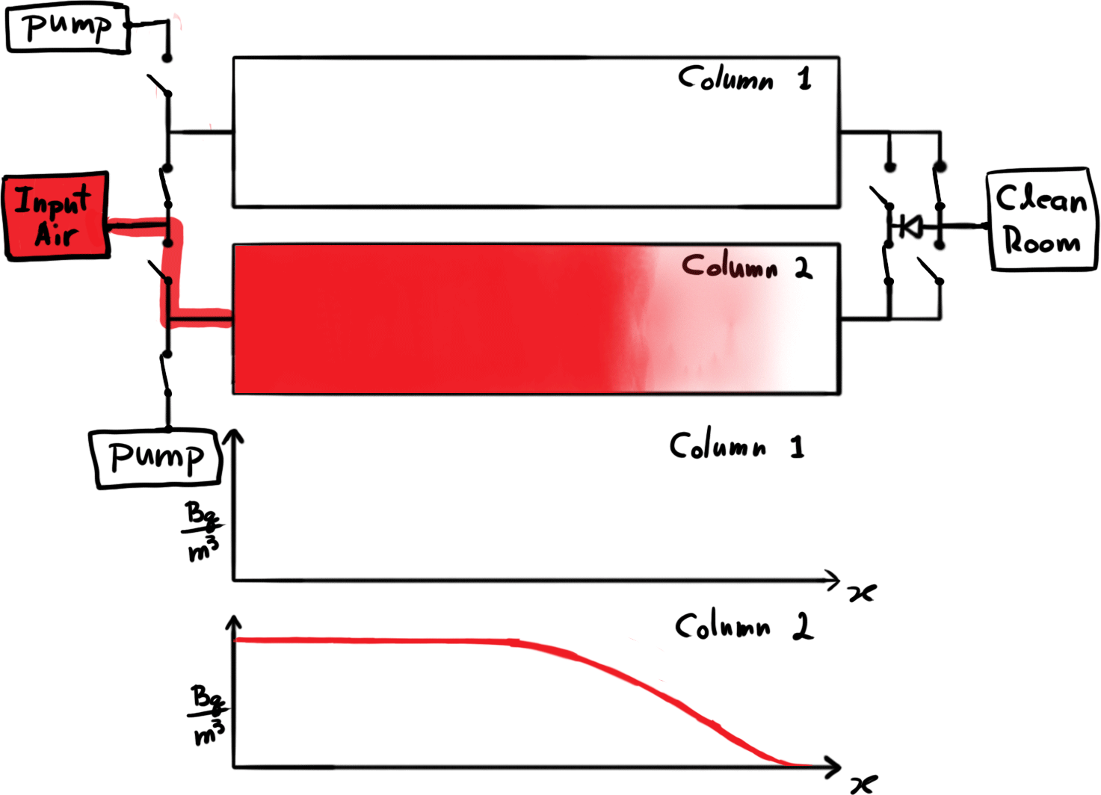

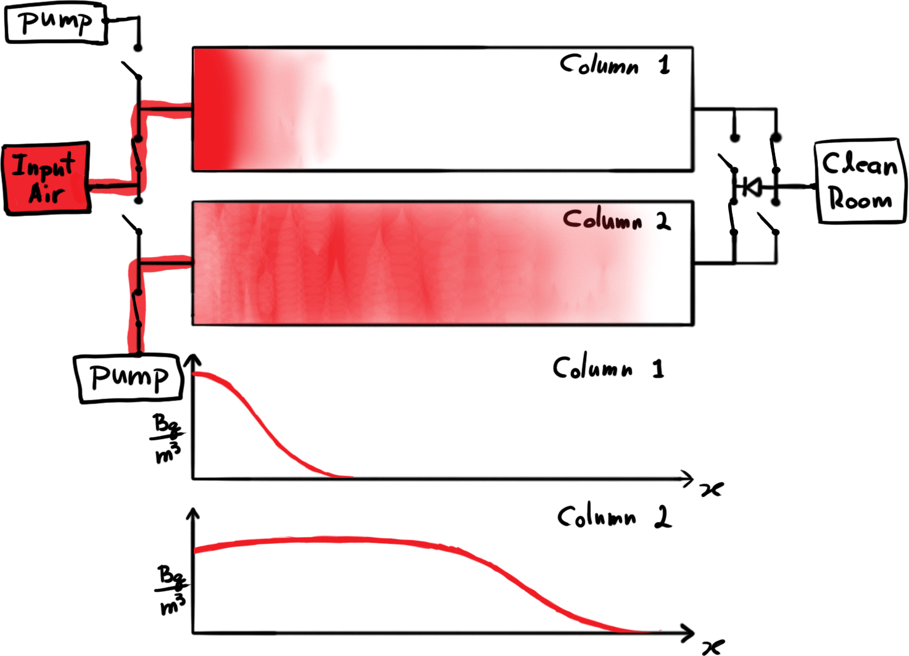
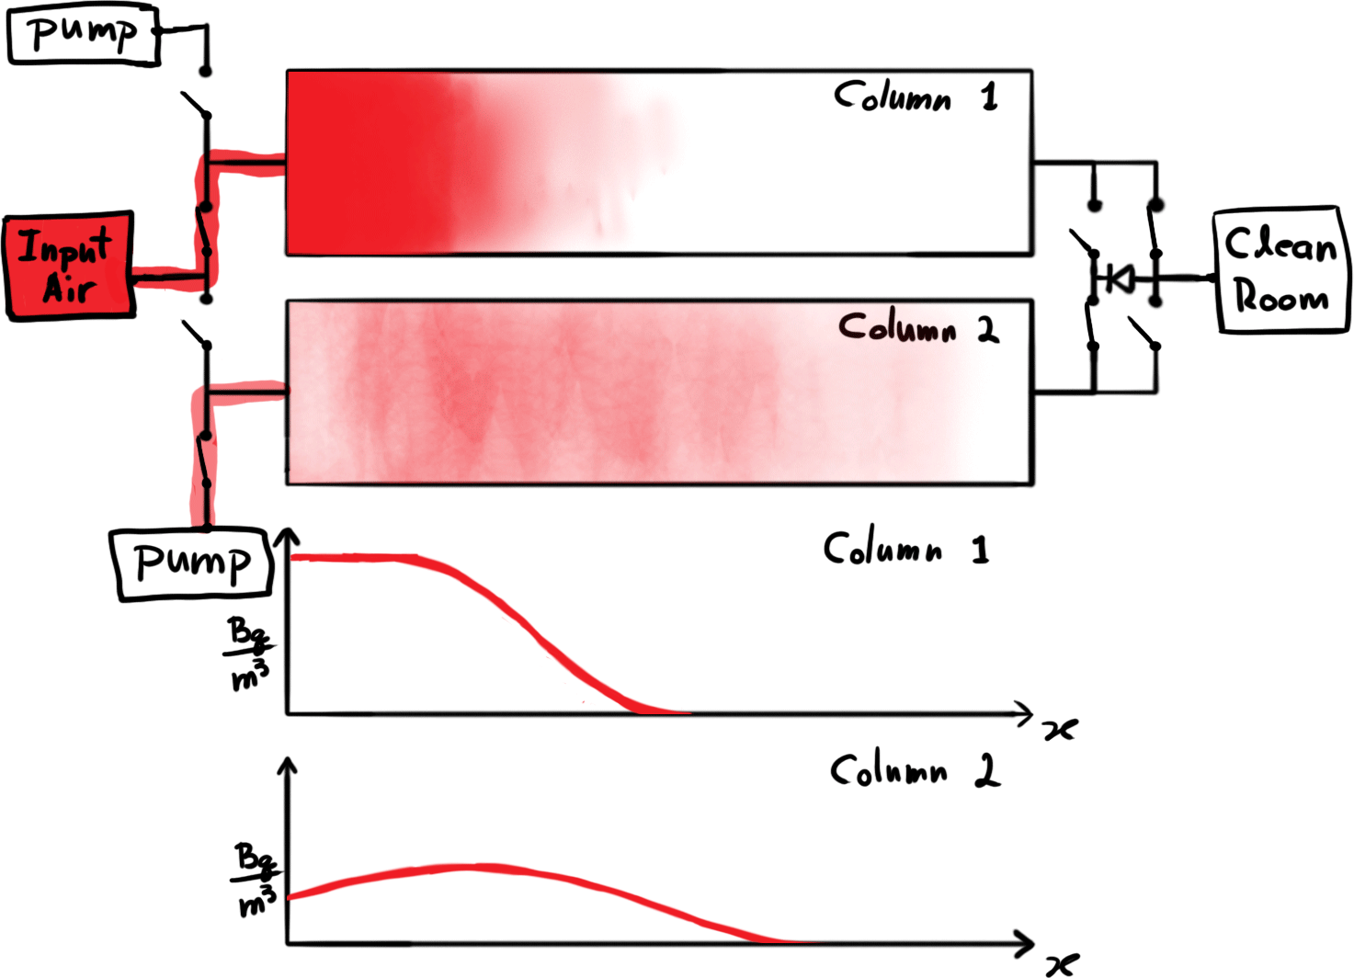
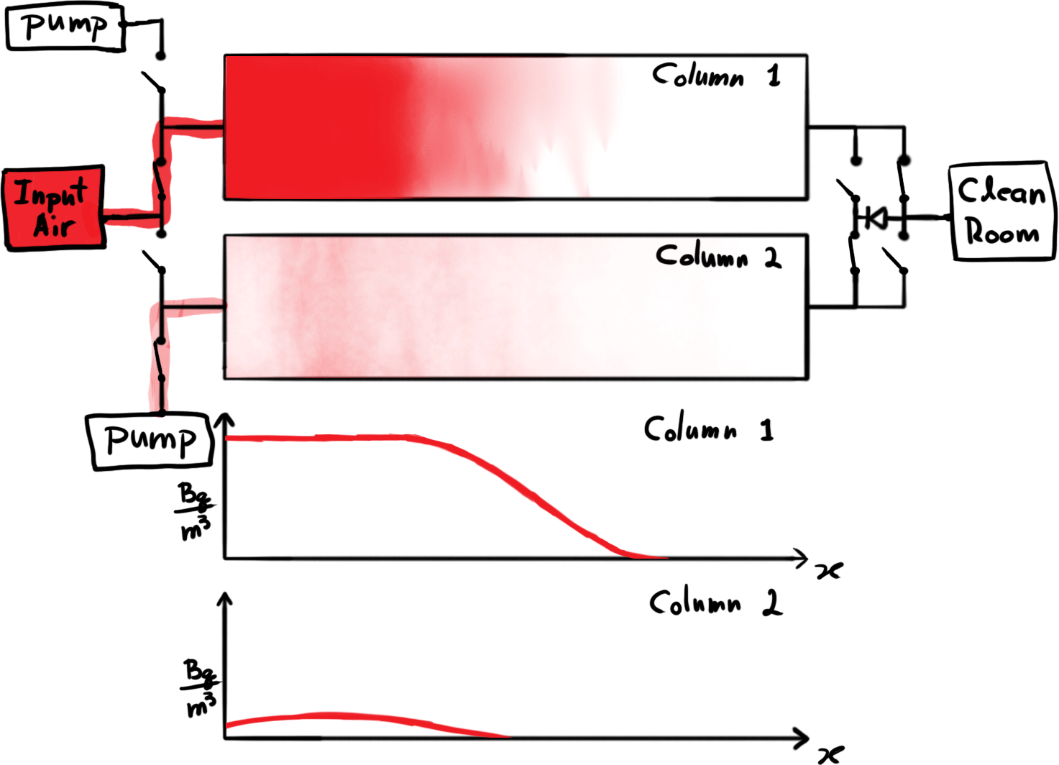

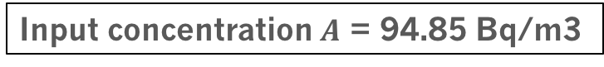
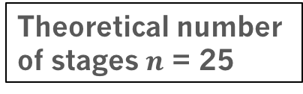
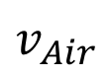
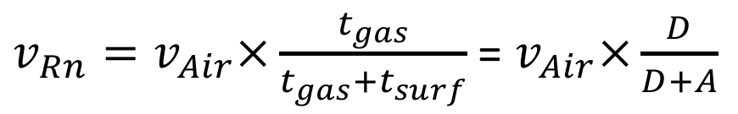
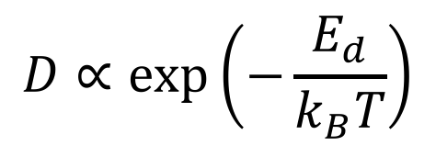

Construction of an Improved Vacuum-Swing-Adsorption Radon Mitigation System
South Dakota School of Mines & Technology: J. Street, R. W. Schnee, R. Bunker,
C. Dunagen, E. H. Miller, X. Loose, M. Stark, K. Sundarnath, D. Tronstad
Experiments that seek to detect very rare processes, such as interactions of the dark matter particles thought to make up 85% of the mass of the universe, may suffer background interactions from radon daughters that have plated out onto detector surfaces. To reduce these backgrounds, an ultra-low-radon cleanroom was built at the South Dakota School of Mines & Technology. Cleanroom air is supplied by an optimized vacuum-swing-adsorption radon mitigation system that has achieved a > 300x reduction from an input activity of 58.6 ± 0.7 Bq/m³ to a cleanroom activity of 0.13 ± 0.06 Bq/m³.
Vacuum Swing Adsorption System
Results – Radon Reduction in Clean Room
Air is dried
INTAKE (outdoor air)
~ 10-100 Bq/m³
This plot shows the radon activity of the input air (higher, orange error bars with 7-day average) compared to that of the air in the cleanroom (lower, blue error bars with 5-day average), showing a > 300x reduction in activity from 58.6 ± 0.7 Bq/m³ to 0.13 ± 0.06 Bq/m³.
BLOWER (100 cfm)
Radon adsorbs to carbon
~ATMOSPHERIC PRESSURE
LOW PRESSURE
BOOSTER
Purging
ROUGHING PUMP
Radon Mitigated Clean Room
125 kg of activated carbon
~ 0.1 Bq/m³
OUTPUT
(to cleanroom)
Desorption rate
Rn-Mitigated Clean Room - Inside
Radon-Mitigated Clean Room - Outside
$$D∝\exp\left(−\frac{E_{d}}{k_{B}T}\right)$$
$$v_{Air}$$
$v_{Rn}=v_{Air}×\frac{t_{gas}}{t_{gas}+t_{surf}}$ = $v_{Air}×\frac{D}{D+A}$
Adsorption rate
HVAC
Reduce desorption rate by reducing temperature
High
Rn air
Low
Rn air
Input concentration $A$ = 94.85 Bq/m3
Preferential adsorption of radon over N₂, O₂ on C since both radon and C are non-polar (Van der Waals interaction).
Radon Elution Curve for single column breakthrough test
Designed for easy taping!
Flow through column = 20 cfm
Theoretical number
of stages $n$ = 25
HVAC
control
panel
Breakthrough time $τ$ = 14 hours
How it works
Large radon-mitigated clean room (21 ft x 9.25 ft with an 8 ft ceiling).
Clean anteroom inside clean room (5 ft x 9.25 ft).
Aluminum walls, ceiling, and flooring.
HVAC inside, HEPA filters, all windows ≥ 1/8 inch polycarbonate (diffusion results in radon source ~ 300 μBq/m³).
Low-radon humidification (Rn contribution on order of 100 μBq/m³).
Sealed with butyl rubber and aluminum tape.
Air is brought in from outside (at ~ 10 Bq/m³) and dehumidified.
Dehumidified air is blown through carbon beds.
Radon in air adsorbs to sites on activated carbon.
Radon-mitigated air overpressures cleanroom.
Some Rn-mitigated air is pumped through 2nd carbon bed for purging.
The system “swings” into reverse operation—with the first carbon bed being purged while the second adsorbs Rn atoms.
Upgrading to
larger carbon beds
Applications for Radon Mitigated Clean Room
Dehumidifier
Low-background experiments must assemble and clean parts in radon-reduced environments. Radon's long-lived daughter, ²¹⁰Pb, plates out onto component surfaces and can produce backgrounds for decades.
Low radon clean rooms will reduce the amount of ²¹⁰Pb on surfaces for these applications:
Assembling the BetaCage
Stringing of the MWPC frames is a time-consuming task requiring delicate work. Radon daughters on these wires could be the detector's largest background.
Assembling or cleaning parts for experiments at SURF.
Larger carbon bed
Original
carbon bed
carbon bed
Booster
Assembling a prototype for the BetaCage, an ultra-low background surface screener
Roughing pump
This work was supported in part by the National Science Foundation (Grant numbers: PHY-1205898 and PHY-1506033 ) and the Department of Energy (Grant No. DE-AC02-05CH1123).
Cartoon simulation of VSA in operation:

